Slide 1


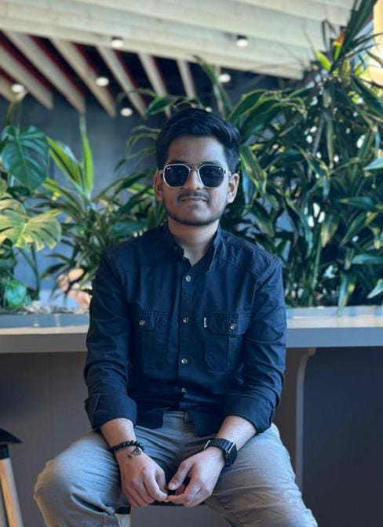
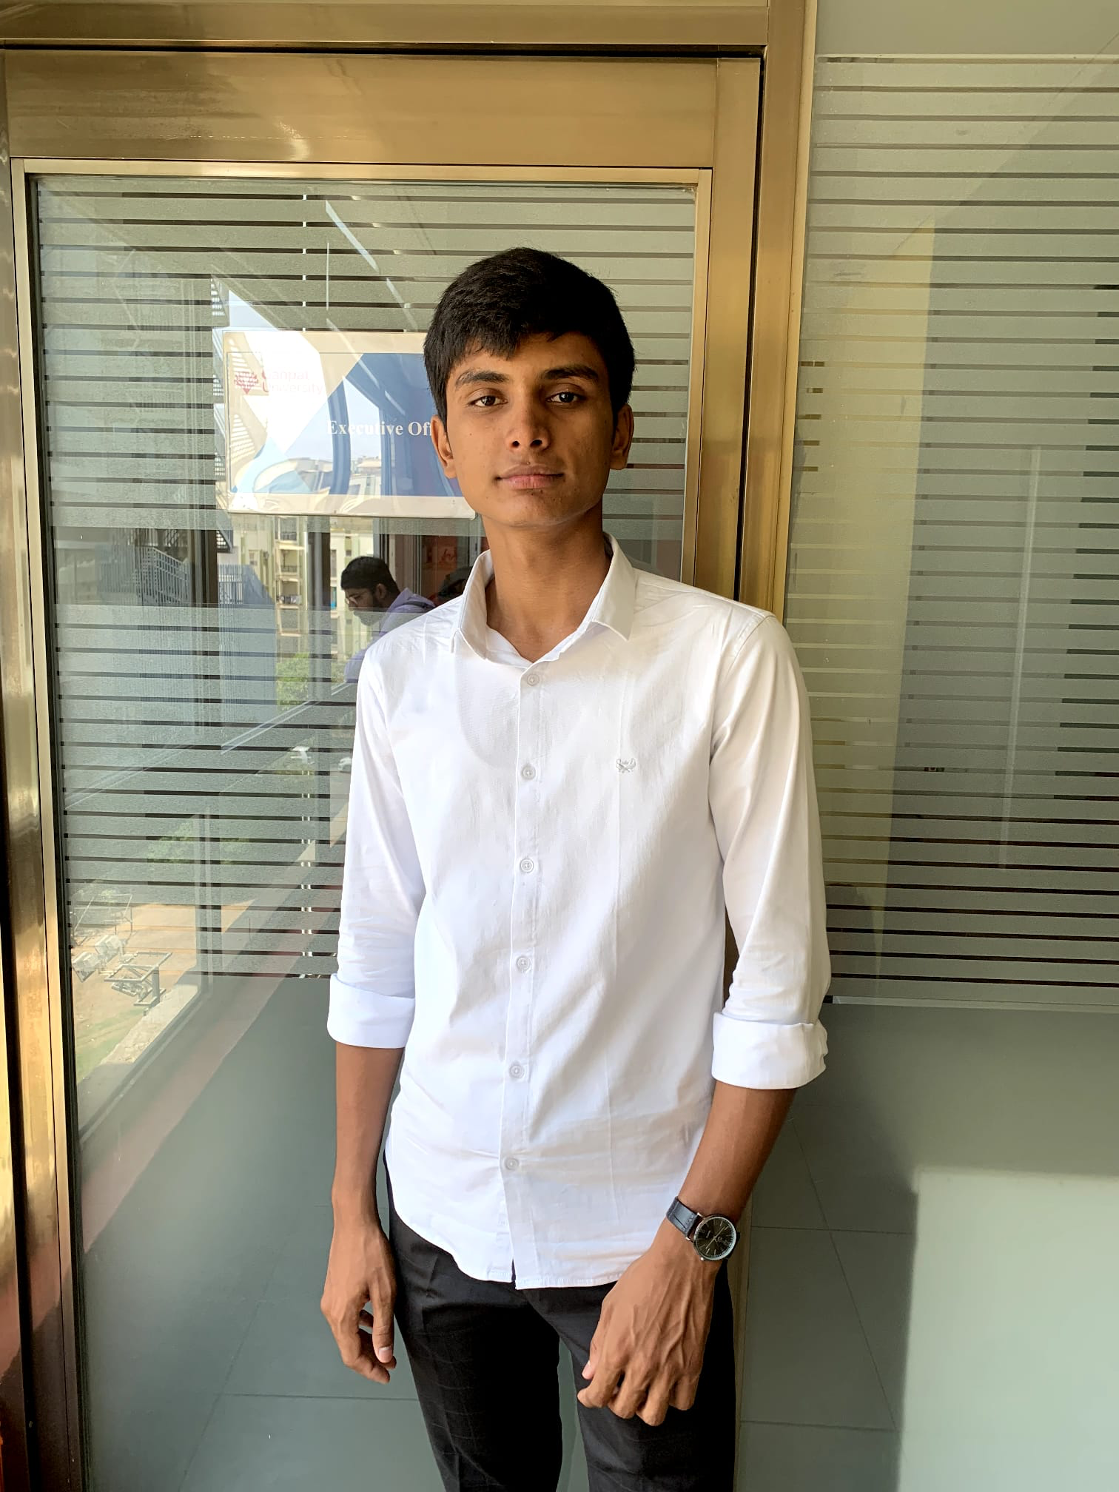
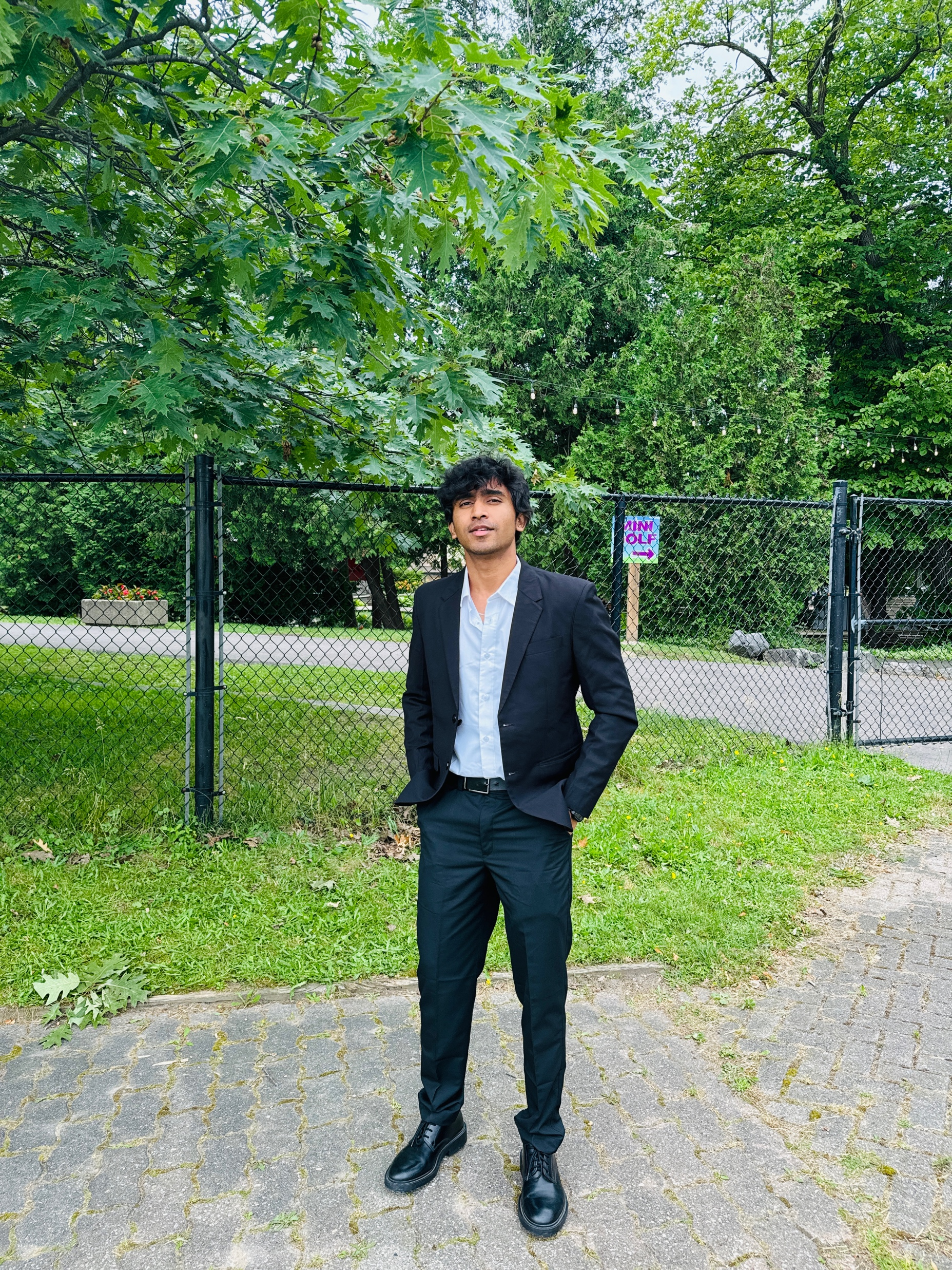

Group Members
Jaykumar Sadaniya(200613915)
Meetkumar Patel (200613280)
Jainam Patel(200612850)

Slide 2
MDEV1001 – Mobile Data Management
UI for Local Data (UI with Full CRUD)

Slide 3
Assignment 2
Part 1 Import your database to the Target Platform (10 Marks): 1. Using an exported version of your database (e.g., in CSV or JSON format), preload your movie data in your database (10 Marks)

Slide 4
Part 2 Your Movie List Screen (40 Marks):
2. Display your 30 Favourite Movies in a Table or similar Element (e.g., RecyclerView).Each Row in
your list should include the Movie Title, Studio, a Thumbnail of the Movie Poster and the Critics Rating (10 Marks). 3. Each Row in your List should use a Custom View (e.g., Custom Table Cell) (10 Marks). 4. Include a UI Element or interaction that allows the User to Add a new movie to the Movie List by navigating to the Add/Edit Screen. When Navigation completes, ensure the Add/Edit screen modifies the Title and the main button to with an appropriate message (e.g., either Add or Edit) (5 Marks). 5. Include a UI Element or interaction that allows the User to Edit an existing movie in the Movie List by navigating to the Add/Edit Screen (5 Marks). 6. Include a UI Element or interaction that allows the User to Delete an existing movie in the Movie List (10 Marks)

Slide 5
Part 3 Your Add / Edit Screen (20 Marks):
Your Add / Edit Screen should include UI Elements (Labels and Text Fields) that allow the user to both view, edit or add a Movie (10 Marks). 8. Your Add / Edit Screen should include a UI Element that allows the user to submit their changes (5 Marks). 9. Your Add / Edit Screen should include a UI Element that allows the user to cancel any changes and navigate back to the Movie List Screen (5 Marks).

Slide 6
Part 4 Your App is Aesthetically Pleasing (10 Marks):
10. You’ve designed your App with good Aesthetic standards including appropriate margins, padding, colours, contrast and overall layout while always keeping the user in mind (10 Marks).

Slide 7
Part 5 Video Presentation
11. Create a Short Video presentation on YouTube or another streaming provider. You must include a short PowerPoint (or Google Slides) Slide Deck that includes a single slide to start your video (10 Marks) f. The first (and only) Slide of your Slide Deck must include a current image of you and team members (no avatars allowed) that is displayed appropriately on the page. You must also include your Full Name(s), Student ID(s), the Course Code, Course Name, and your Assignment information. g. You will demonstrate your database’s functionality. h. Sound for your Video must at an appropriate level so that your voice may be clearly heard. i. Your screen resolution should be set so that your code and app demonstration is clearly visible. j. Your Short Video should run no more than 5 minutes. k. Your Video may be unlisted, but must be accessible to the instructor

Slide 8
Part 6 Version Control (10 Marks)
. Share your files on GitHub to demonstrate Version Control Best Practices 2. Your repository must be private with your instructor added as a collaborator(shivi359@gmail.com). 3. Your repository must be appropriately named. 4. Your repository must be well structured. 5. Your repository must include your code. 6. Your repository must include commits that demonstrate the project being updated at different stages of development – each time a major change is implemented. All team members must be shown to have made commits to the code base (i.e., you must demonstrate that each person on the team is an equal partner). If there will be no detail commits, then the assignment would be graded as zero.

Slide 9
Thank You

